Slide 1

LAB 3
JAVASCRIPT DEMO

Slide 2
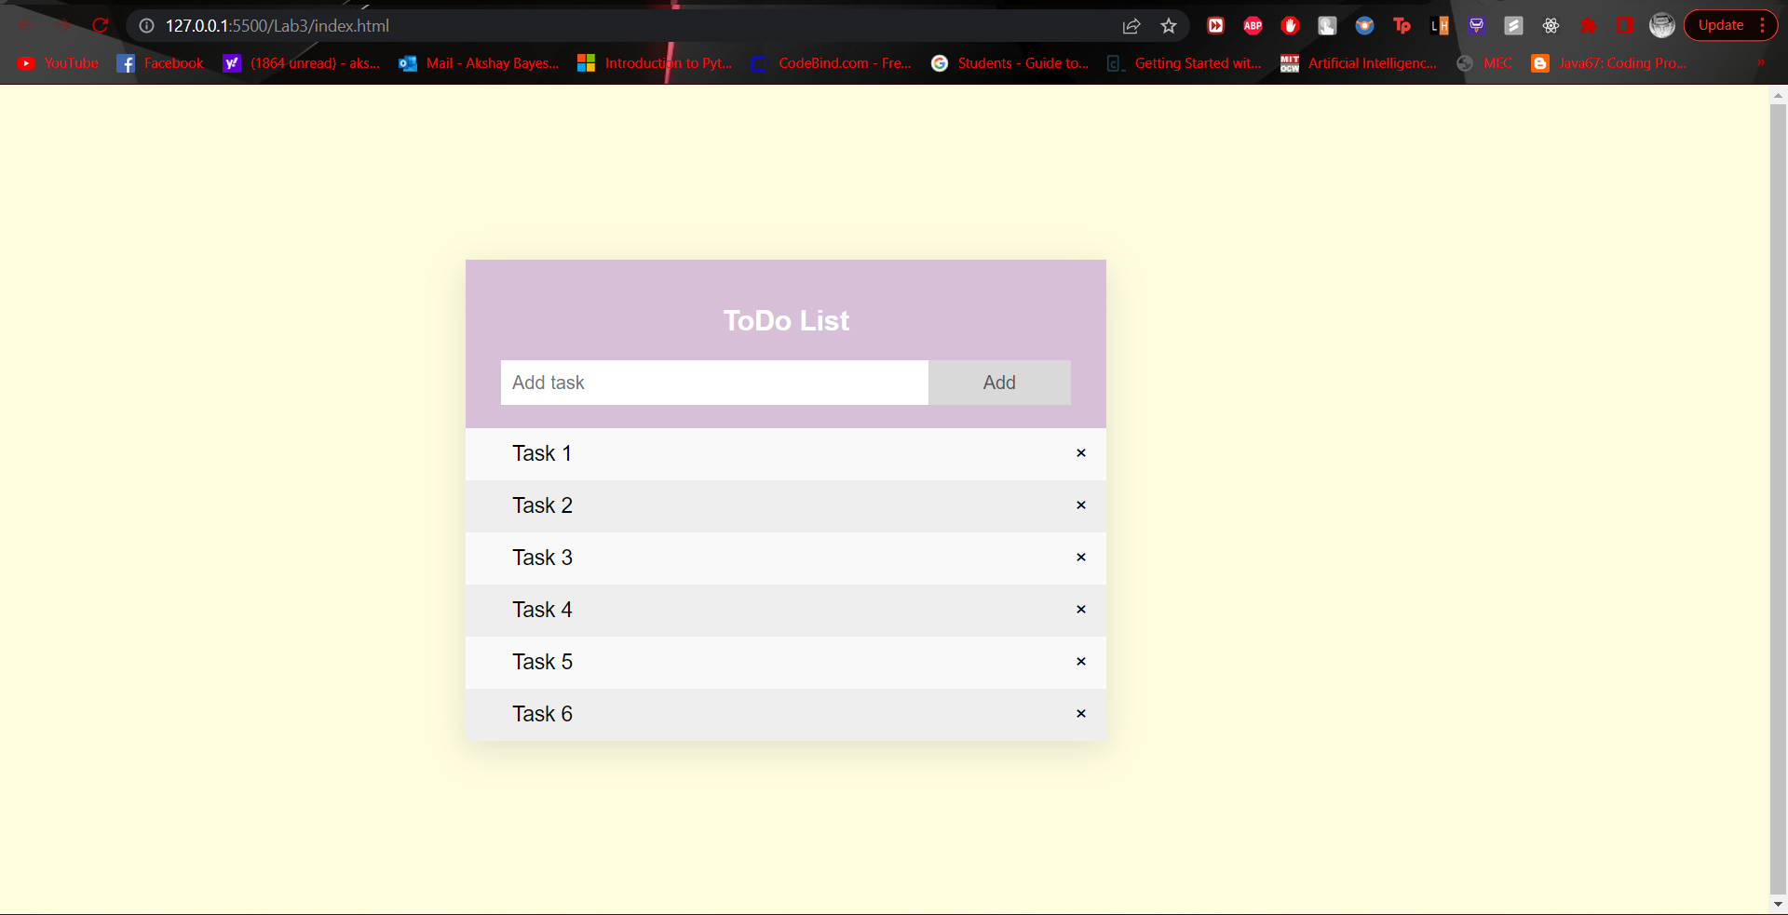
Demo Website for today

Slide 3
Add Meta tags and Font link
Start with Head tag and add title to it.
Add required meta tags as follows: <meta charset="UTF-8"> <meta http-equiv="X-UA-Compatible" content="IE=edge"> <meta name="viewport" content="width=device-width, initial-scale=1.0">
Add google font links as follows: <link rel="stylesheet" href="styles.css"> <link href="https://fonts.googleapis.com/css2?family=Cormorant&family=Cormorant+Garamond:wght@300&family=Epilogue:wght@300&family=Montserrat:wght@300&family=Open+Sans:wght@300;400&family=Quicksand:wght@500&family=Roboto+Mono:wght@200&family=Roboto:wght@300;700&display=swap" rel="stylesheet">

Slide 4
Add JS and CSS file
Create new JS file and add it inside body tag using script tag:
<script src="script.js"></script>
Create new CSS file and add CSS file inside head tag:
<link rel="stylesheet" href="styles.css">

Slide 5
Add HTML Code
Add heading, input box and a span button: <div id="myDiv" class="header"> <h2>To-Do List</h2> <input type="text" id="myInput" placeholder="Add task"> <span class="addBtn" onclick="newElement()">Add</span> </div>
Add an unordered list to display task: <ul id="myUL"> <li>Task 1</li> <li>Task 2</li> <li>Task 3</li> </ul>

Slide 6
Add CSS Code
Add CSS to body tag: body{ margin: 150px 150px 150px 400px; width: 550px; font-family: 'Epilogue', sans-serif; background: #fffDDE; box-shadow: rgba(100, 100, 111,0.2) 0px 7px 29px 0px; }
Add border to the box: *{ box-sizing: border-box; }
Remove margin and padding of the unordered list: ul{ margin: 0; padding: 0; }

Slide 7
Add CSS Code (Continue)
Add more CSS to unordered list items: ul li{ cursor: pointer; position: relative; padding: 12px 8px 12px 40px; list-style-type: none; background: #eee; font-size: 18px; }
Add color to alternate rows: ul li:nth-child(odd){ background-color: #f9f9f9; }
Add hover effect for each item: ul li:hover{ background: #ddd; }

Slide 8
Add CSS Code (Continue)
Add CSS to Add Button: .addBtn{ padding: 10px; width: 25%; background: #d9d9d9; color: #555; float: left; text-align: center; font-size: 16px; cursor: pointer; /* border-radius: 12px; */ }
Add hover effect for Add button: .addBtn:hover{ background-color: #bbb; }

Slide 9
Add CSS Code (Continue)
Add CSS to header div: .header{ background-color: thistle; adding: 20px 30px; color: white; text-align: center; }
Add after effect for header div: .header:after{ content: ""; display: table; clear: both; }
Add CSS to input tag: input{ margin: 0; border: none; border-radius: 0; width: 75%; padding: 10px; float: left; font-size: 16px; }

Slide 10
Add JavaScript Code
Add JavaScript function- newElement() function newElement(){ var li = document.createElement("li"); var inpValue = document.getElementById("myInput").value; var t = document.createTextNode(inpValue); li.appendChild(t); if(inpValue === ""){ alert("Please enter the value"); }else{ document.getElementById("myUL").appendChild(li); } document.getElementById("myInput").value=""; var span = document.createElement("SPAN"); var txt = document.createTextNode("\u00D7"); span.className = "close"; span.appendChild(txt); li.appendChild(span); for(i=0;i<close.length;i++){ close[i].onclick = function(){ var div = this.parentElement; div.style.display="none“ } } }

Slide 11
Add JavaScript Code (CoNTInue)
Add JavaScript code to delete to-do list: var myNodelist = document.getElementsByTagName("LI"); for(var i=0; i<myNodelist.length; i++){ var span = document.createElement("SPAN"); var txt = document.createTextNode("\u00D7"); span.className = "close"; span.appendChild(txt); myNodelist[i].appendChild(span); } var close = document.getElementsByClassName("close"); for(var i=0; i<close.length;i++){ close[i].onclick = function(){ var div = this.parentElement; div.style.display = "none"; } }

Slide 12
Add CSS Code (Continue)
Add CSS to Close Button: .close{ position: absolute; right:0; top:0; padding: 12px 16px 12px 16px; }
Add hover effect for Close button: .close:hover{ background-color: #9eeeee; color: white; }
------------------------------- THE END --------------------------------------

